Slide 1
Blind Deblurring Using Internal Patch Recurrence
GROUP 3:
Yifeng Huang, Zijian Qiao
Yunzhe Cao, Shangru Huang

Slide 2
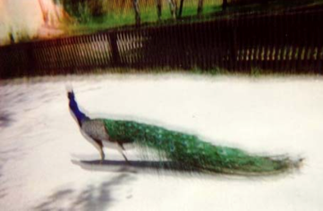

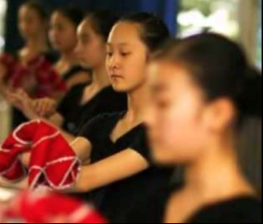
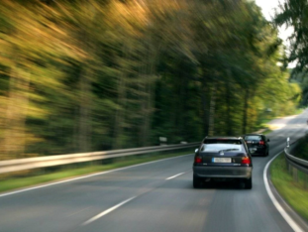
Types of Blur
Hand shake
Scene motion
Out of plane
Defocus blur
http://www.cs.unc.edu/~lazebnik/research/fall08/lec05_deblurring.pdf
Notes:
Camera shake: User moving hands(The blurry peacock is the result of shaky hands)
Scene motion: Objects in the scene moving
Defocus blur: Depth of field effects
Out of Plane: There is a speed of the object in the direction perpendicular to the image plane

Slide 3
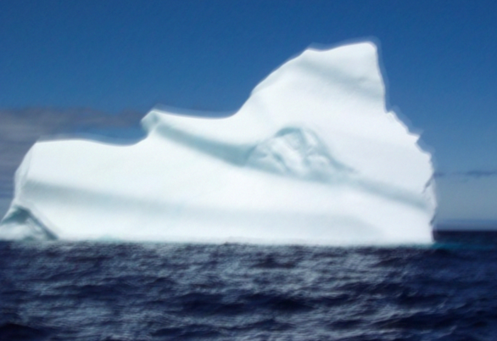
Presumption of the Deblurring
Hand shake blur
Out of focus blur with little depths of fields

Slide 4
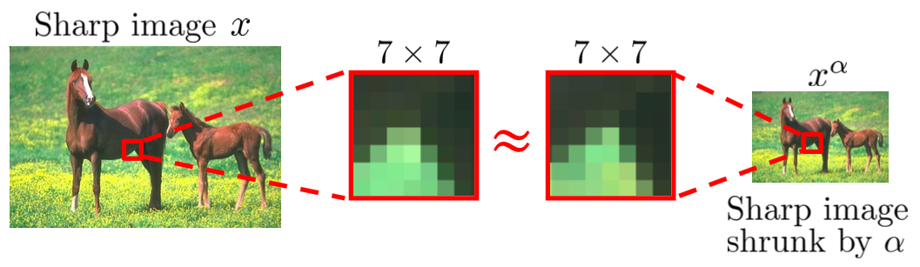
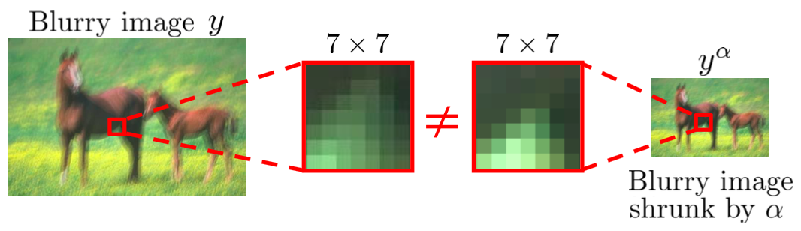
Internal Patch Recurrence
Patch recurrence across scales in a sharp image
In a blurry image, cross-scale patch recurrence deminishes

Slide 5
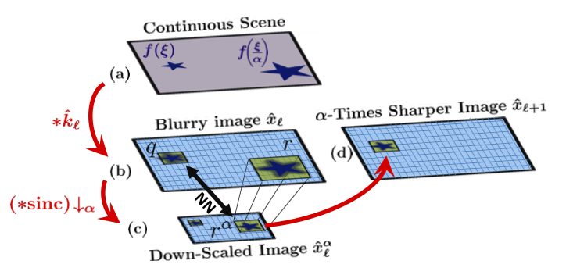
T. Michaeli and M. Irani
Step 1: Down scale Find nearest neighbor (NNs)

Slide 6


T. Michaeli and M. Irani
Step 2: Deblurring Using Internal Patch Recurrence
Step 3: Kernel Update

Slide 7
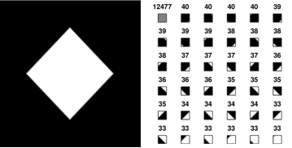
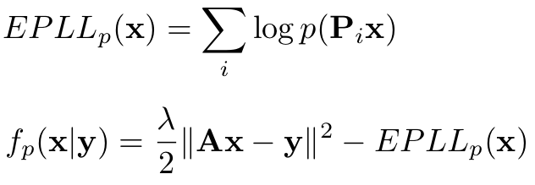
D. Zoran and Y. Weiss
Learn Prior
Restore image by maximizing Expected Patch Log Likelihood (EPLL)

Slide 8

Michaeli VS. EPLL
Michaeli&Irani’s algorithm
Test
Michaeli&Irani
Deblur image
Blur image
Blur kernel
EPLL
Deblur image
Gaussian

Slide 9

Michaeli VS. EPLL
Input: 4 images
Method:
Output:
Image | Error ratio
Img 1 | 1.006
Img 6 | 0.9111
Img 10 | 1.0112
Img 39 | 0.9702
Average error ratio = 0.9746

Slide 10
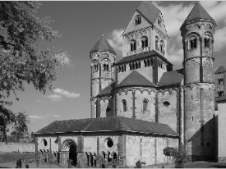
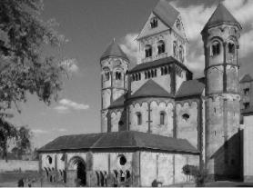
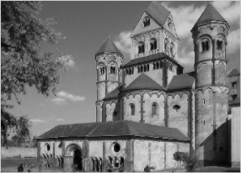
Michaeli VS. EPLL
Goundtruth
Michaeli&Irani
EPLL

Slide 11
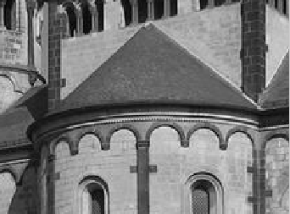
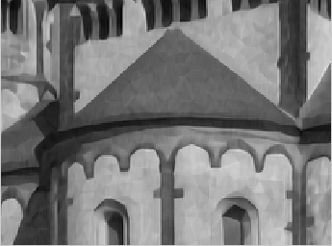
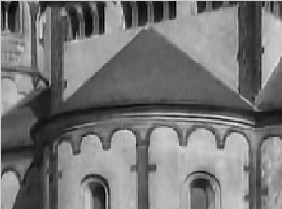
Michaeli VS. EPLL
Goundtruth
Michaeli&Irani
EPLL

Slide 12
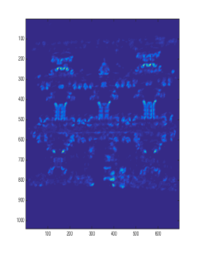
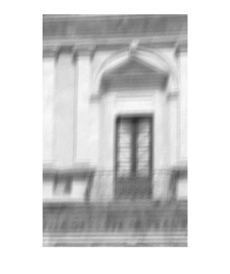
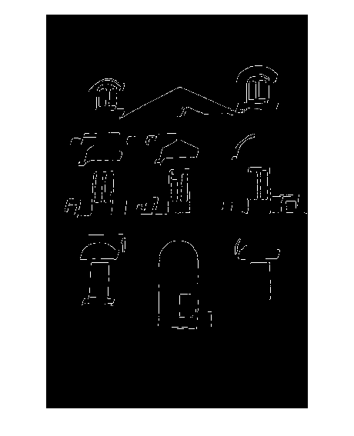
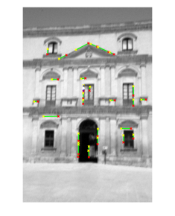
Auto crop to get good regions
1, Get line segments: canny edge detector and hough transform
2, Detect corners: minimum eigenvalue corner detector
3, Give weight to each line segment

Slide 13

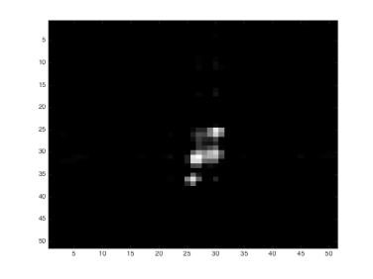
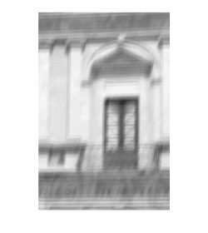
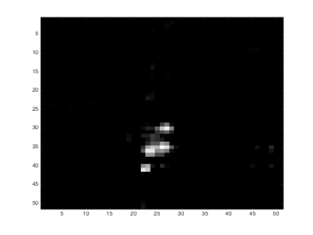
Auto crop to get good regions
Whole image:
4~5 hours
Cropped image:
40~50 mins

Slide 14
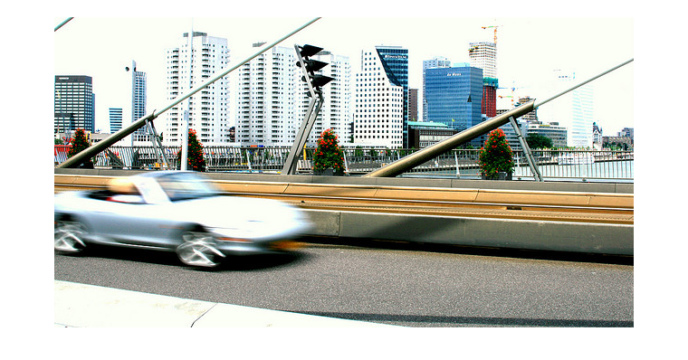
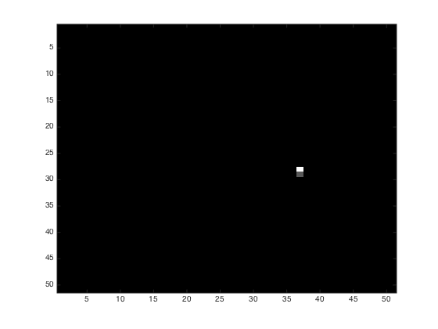
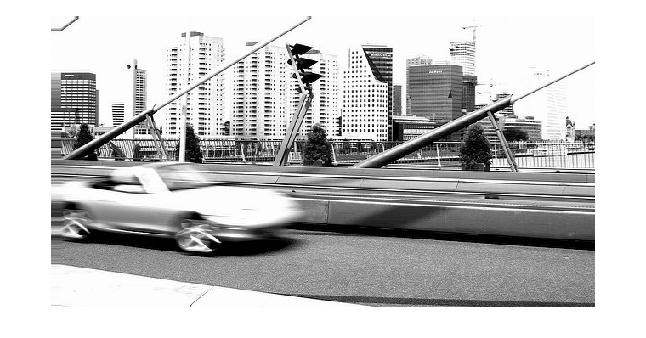
Un-uniform kernel ?
Different kernel on the car and the clear background

Slide 15
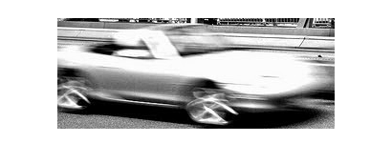
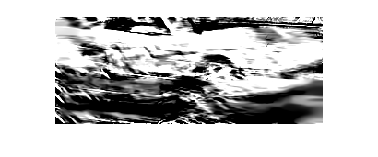
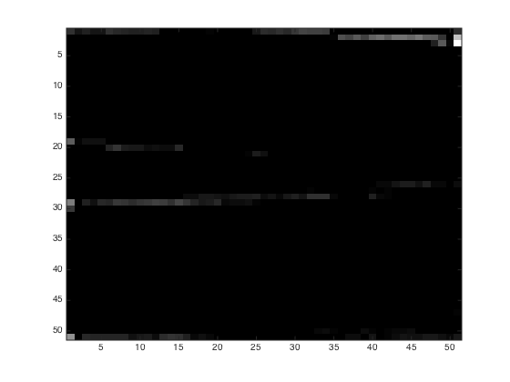
Segment out the moving object ?
Limitation 1:
The sub-image cannot be too smooth.

Slide 16
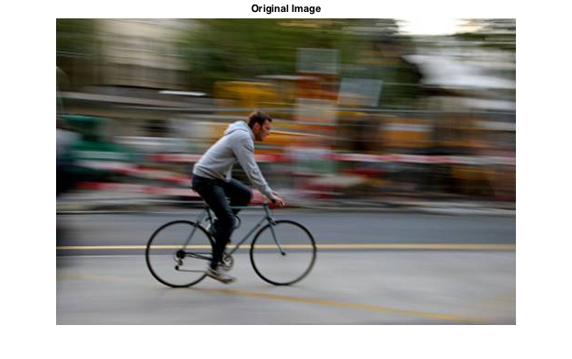
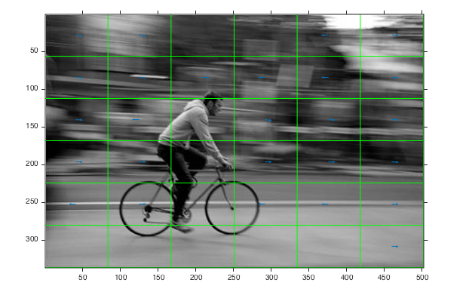
Grid of spatial localized kernel ?
Limitation 2:
Each grid of sub-image being too small to provide enough information for nearest-neighbor patch matching.

